Slide 1
Proofing Documents
Microsoft Word 2013
Lesson 9

Slide 2
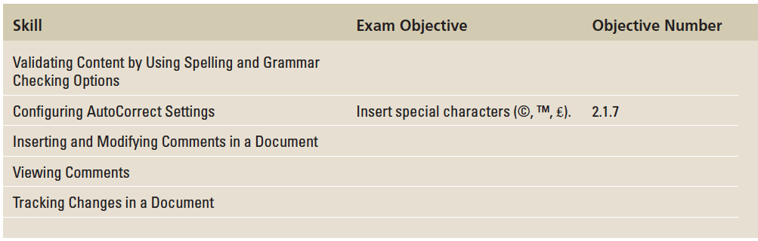
Objectives

Slide 3
Software Orientation
The Proofing group on the Review tab contains commands for launching Word’s Spelling and Grammar functions, searching through references, using the Thesaurus, and counting words by characters, paragraphs, and lines.
The Language group contains commands for translating words or paragraphs and an option to select a language.
These and other commands for reviewing and editing Word documents are located on the Review tab, shown on the next slide.

Slide 4
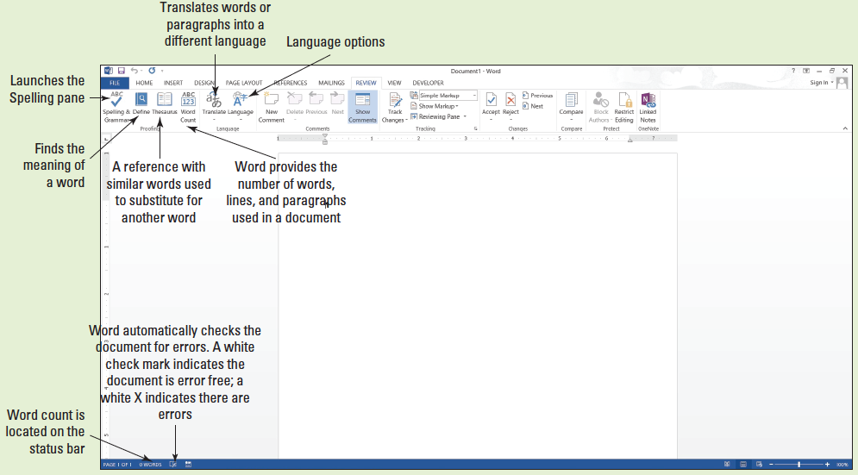
Software Orientation

Slide 5
Validating content by using spelling and grammar checking options
It is a good business practice to proof a document to ensure it is error free before sharing or printing it.
Word provides proofing tools such as a Spelling and Grammar checking function, the Define button, the Thesaurus button, and the Word Count tracker.
All these tools and commands are located on the Ribbon on the Review tab.
The status bar also contains Word Count and Proofing Error buttons that give you quick access to some proofing features. On the status bar, Word automatically displays the document’s word count.

Slide 6
Checking the Spelling and Grammar Feature
Microsoft Word’s Spelling and Grammar feature is automatically on by default and checks the spelling and grammar in a document.
Word underlines misspelled words with a wavy red line and underlines grammatical errors with a wavy green line.
Proper nouns are usually not found in the dictionary, so they will often be underlined with a wavy red line even if the word is spelled correctly. If there is a word that you use often that is not found in the dictionary, you might want to add it to your dictionary.
Adding words to the dictionary is not covered in this lesson. Word can often detect whether words are used inappropriately and it underlines the word with a wavy blue line. In other words, if a word is underlined in blue, the word is in the dictionary but not used correctly in the context.

Slide 7
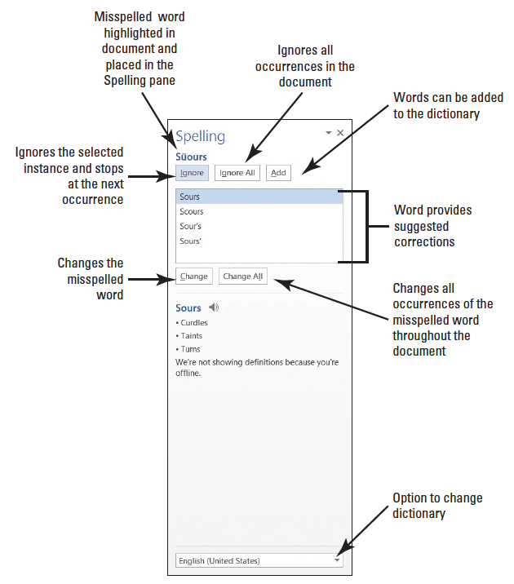
Step by Step: Check Spelling and Grammar
GET READY. Before you begin these steps, launch Microsoft Word.
OPEN the Employ Offer document from the lesson folder.
Click the Review tab, and then click the Spelling & Grammar button in the Proofing group. The Spelling pane opens—this is a new appearance for this feature (right).

Slide 8
Step by Step: Check Spelling and Grammar
The first word appearing in the Spelling task pane is Süours, a proper noun not contained in the tool’s dictionary. The Spelling task pane provides a listing of suggested words as shown previously.
Click the Ignore All button to ignore all occurrences within the document, because Süours is not in the main dictionary and it’s spelled correctly.
The word cofim is misspelled. The correct spelling is the second option.
Click the Change All button to change all occurrences.
The next misspelled word is employmnt. The correct spelling is highlighted. Click the Change All button.

Slide 9
Step by Step: Check Spelling and Grammar
The next misspelled word is beginning; the correct spelling is highlighted in the Suggested pane. Click the Change All button.
The next misspelled word is asistance. Click the Change All button.
A grammar error of in the amount of appears in the task pane. Click Ignore. This is covered later in the lesson.
The next misspelled word is another proper noun, Sheila. Some proper nouns are added in the main dictionary. The correct spelling is highlighted. Click the Change All button.

Slide 10
Step by Step: Check Spelling and Grammar
A prompt appears when the Spelling and Grammar check is complete. Click OK.
Notice how the icon on the status bar changes from an X to check mark.
SAVE the document as Employment Offer in the lesson folder on your flash drive.
PAUSE. LEAVE the document open to use in the next exercise.
Notes:
Take Note: Ignore Once ignores the occurrence once and stops at the next occurrence.

Slide 11
Rechecking the Spelling and Grammar
Word has the option for users to ignore misspelled words.
Once you ignore a misspelled word, it will no longer be marked with a wavy red line until you recheck the document.
You will recheck the document to ensure you have captured all errors.

Slide 12
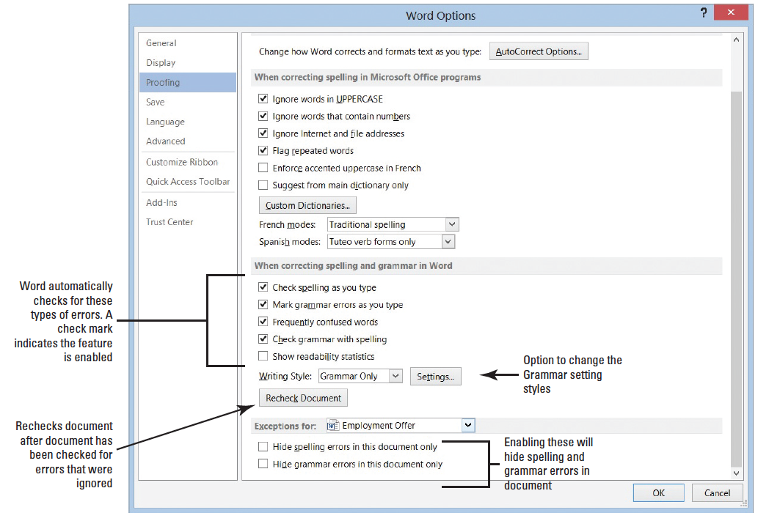
Step by Step: Recheck Spelling and Grammar
USE the document that is open from the previous exercise.
Click the File tab, and then click Options to open the Word Options dialog box in Backstage.
Select Proofing in the left pane and review the section When correcting spelling and grammar in Word (above). The check marks indicate that the feature is enabled.

Slide 13
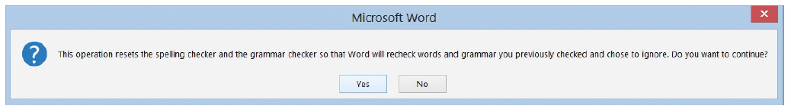
Step by Step: Recheck Spelling and Grammar
Click the Recheck Document button to check for errors that were ignored.
A prompt appears stating This operation resets the spelling checker and the grammar checker so that Word will recheck words and grammar you previously checked and chose to ignore. Do you want to continue? Click Yes (below). The document flags misspellings.

Slide 14
Step by Step: Recheck Spelling and Grammar
Click OK to close the Word Options dialog box.
In the Proofing group, click the Spelling and Grammar button. The Spelling task pane opens.
The Spelling and Grammar tool highlights Süours. This spelling is correct, so click Ignore All.
The tool now ignores every occurrence of this spelling in the document.
SAVE the document as in the lesson folder on your flash drive.
PAUSE. LEAVE the document open to use in the next exercise.
Notes:
Take Note: When Word detects a spelling error, you can choose to change one occurrence of the instance or change all instances. Click Change to change a single occurrence or click Change All to change all occurrences in the document.
Another Way: Click the Proofing Error button on the status bar (or press the keyboard shortcut, F7) to open the Spelling task pane. You can also right-click on a misspelled word, and Word displays a shortcut menu with suggested words at the top.
Take Note: If you run the Spelling and Grammar command in the middle of the document, it will check from that point to the end of the document. A prompt will appear asking if you want to continue checking the document from the beginning.

Slide 15
Changing the Grammar Settings
Word’s grammar settings let you determine the punctuation and other stylistic guidelines by which the program will check for and detect errors.
You can change the writing style to check for grammar only or check stylistic rules, such as contractions, hyphenated and compound words, sentence length (more than sixty words), and more.

Slide 16
Step by Step: Change the Grammar Settings
USE the document from the previous exercise.
Click the File tab, and then click Options to open the Word Options dialog.
Select Proofing in the left pane and in the When correcting spelling and grammar in Word section.

Slide 17
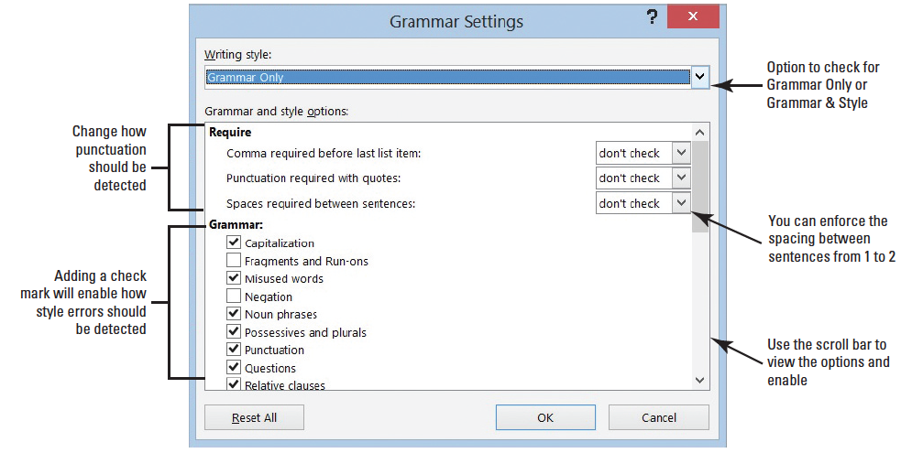
Step by Step: Change the Grammar Settings
Click the Settings button to open the Grammar Settings dialog box. This dialog box lists the writing style where you can customize the Grammar Only or Grammar & Style (below).

Slide 18
Step by Step: Change the Grammar Settings
Click the drop-down arrow in the Writing Style section and select Grammar & Style.
Under the Require section, the Spaces required between sentences setting is set to don’t check. Click the drop-down arrow and select 2. You are changing the style to reflect two spaces after the punctuation between each sentence.
Click OK.
In the Word Options dialog box, under the When correcting spelling and grammar in Word section, click the Recheck Document button.
Notes:
Take Note: The current standard is one space after a punctuation mark. However, in this example we are using two spaces to illustrate Word’s error-checking abilities more clearly.

Slide 19
Step by Step: Change the Grammar Settings
A prompt appears stating that This operation resets the spelling checker and the grammar checker so that Words will recheck words and grammar you previously checked and chose to ignore. Do you want to continue? Click Yes.
Click OK to close the Word Options dialog box. Word flags and marks the punctuation at the end of sentences with a blue wavy line because there is only one space, and we selected 2. Notice in the second paragraph, the document flags are issued.
Right-click on the phrase and a pop-up menu appears. It states “Passive Voice (consider revising).”
Press ESC to close the pop-up menu.

Slide 20
Step by Step: Change the Grammar Settings
Repeat steps 1 and 2 to open the Grammar Settings dialog box.
Under the Require section, click the drop-down arrow to change the Spaces required between sentences setting to don’t check.
Scroll down and disable all Styles with the exception of Clichés, Colloquialisms, and Jargons. One style is kept active.
Click OK.

Slide 21
Step by Step: Change the Grammar Settings
In the Word Options dialog box, under When correcting spelling and grammar in Word section, click the Recheck Document button. A prompt appears stating that This operation resets the spelling checker and the grammar checker so that Word will recheck words and grammar you previously checked and chose to ignore. Do you want to continue?
Click Yes.
Click OK to close the Word Options dialog box. Notice “are issued” in the second paragraph is no longer flagged. In the third paragraph, the phrase “in the amount of” is flagged with a blue wavy line.

Slide 22
Step by Step: Change the Grammar Settings
When you right-click on the phrase, the pop-up menu appears with a suggestion to change to for. Click on the word to accept the suggestion. This is a word or phrase that may be overused or unnecessary to the meaning of your sentence. To quit checking for these types of style errors, you repeat steps 7–10 to disable Clichés, Colloquialisms, and Jargons.
Repeat steps 1–3 to open the Grammar Settings dialog box. Click the Writing Style command box drop-down arrow and select Grammar Only to set the tool for checking the document’s grammar.

Slide 23
Step by Step: Change the Grammar Settings
Notice “are issued” in the second paragraph is no longer flagged. In the third paragraph, the phrase “in the amount of” is flagged with a blue wavy line.
Click OK to apply changes.
SAVE your document in the lesson folder on your flash drive.
PAUSE. LEAVE the document open to use in the next exercise.

Slide 24
Understanding the Meaning of a Word
Microsoft Word has added a new command to learn the meaning of a word.
This is beneficial to you especially when a dictionary is not available.
Before clicking on the Define button, you need to install the dictionary in your computer.

Slide 25
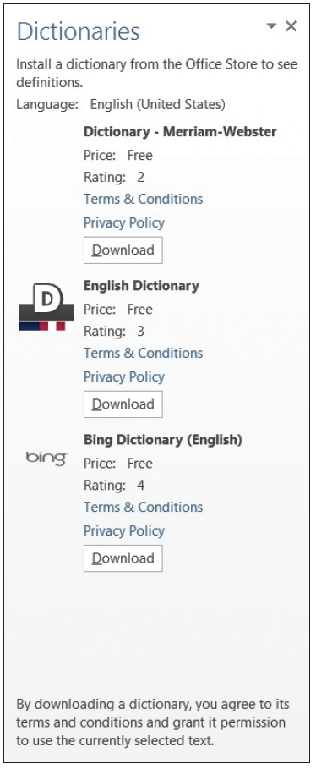

Step by Step: Understand the Meaning of a Word
USE the document from the previous exercise.
Click the Define button.
The Dictionaries task pane opens with options of free dictionaries to install as shown at right. The terms and conditions, and privacy policy links are available for review and acceptance. The ratings for each dictionary is also shown.

Slide 26
Step by Step: Understand the Meaning of a Word
Click the Download button under English Dictionary and begin down- loading the dictionary application. The process for downloading is quick (right).
Select employment in the first paragraph.

Slide 27
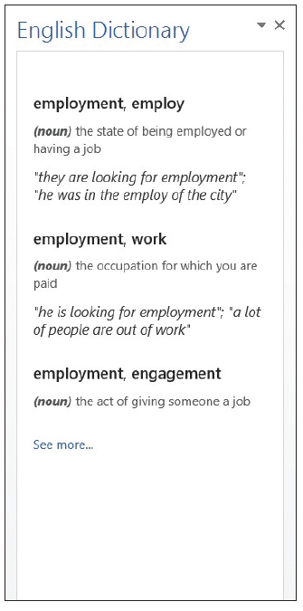
Step by Step: Understand the Meaning of a Word
The definition of the selected text is shown at right. This new feature in Word saves you time from having to manually look up a word in a dictionary book. You must be signed into your Microsoft account before you access this feature.
Close the Dictionary task pane.
SAVE the document in the lesson folder on your flash drive.
PAUSE. LEAVE the document open to use in the next exercise.
Notes:
Another Way: Press Ctrl+F7 to open the Dictionaries task pane or right-click on the selected text for the suggested spelling.

Slide 28
Finding Words Using the Thesaurus
A Thesaurus provides a listing of synonyms and antonyms of common words to help you expand your choice of words in your document.
A synonym is defined as a word that has the same meaning as another word (for example, good and great).
An antonym is the opposite meaning of the word (such as good and bad).
The Thesaurus is a great tool to use when working on research papers or other documents and will assist you in avoiding using the same words multiple times.
If you have difficulty in pronouncing a word, you can hear how the word is pronounced in the Thesaurus task pane.

Slide 29
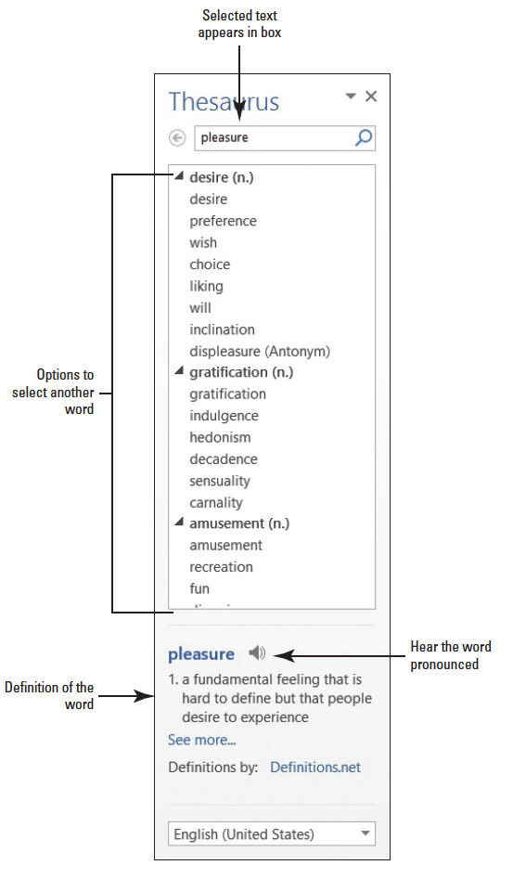
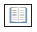
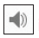
Step by Step: Find Words Using the Thesaurus
USE the document from the previous exercise.
Select pleasure in the first paragraph and click the Thesaurus button.
The Thesaurus task pane opens displaying many options to select as shown at right.
Click the icon to hear the pronunciation of the word.

Slide 30
Step by Step: Find Words Using the Thesaurus
Replace the word with the synonym gratification by moving the mouse over gratification in the Thesaurus task pane, and then click the drop-down arrow and select Insert. If you click on a word in the task pane, Word displays a new listing of words to choose.
Close the Thesaurus task pane by clicking the Close button.
SAVE the document in the lesson folder on your flash drive.
PAUSE. LEAVE the document open to use in the next exercise.
Notes:
Another Way: Press Shift+F7 to open the Thesaurus task pane or right-click on the selected text for the shortcut method.

Slide 31
Configuring AutoCorrect Settings
The Prooﬁng pane of the Word Options dialog box also contains Word’s AutoCorrect setting options.
AutoCorrect is a feature that replaces symbols, commonly misspelled words, and abbreviations for specific text strings. For instance, to add the Trademark symbol, type (tm) and it automatically inserts the symbol ™.
As you can see, AutoCorrect saves time in typing text. You can manage the list of exceptions in the AutoCorrect Exceptions dialog box, such as not capitalizing the first letter of an abbreviation.
You can disregard two initial caps, such as a student ID, or you can customize and add or delete text.
AutoCorrect is on by default, but you can use the AutoCorrect options to disable or enable the feature.

Slide 32
Step by Step: Configure AutoCorrect Options
USE the document from the previous exercise.
Click the File tab to open the Backstage, and then click Options to display the Word Options dialog box.
Click Proofing on the left pane to display the Proofing options in the right pane of the screen. Under the AutoCorrect option, you can change how Word corrects and formats text as you type.

Slide 33
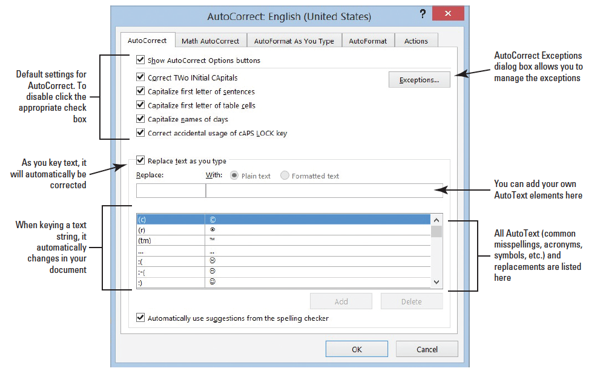
Step by Step: Configure AutoCorrect Options
Click the AutoCorrect Options button to display the AutoCorrect dialog box with the AutoCorrect tab open, as shown below. Notice that the dialog box title indicates that the program is set to check and correct text based on U.S. English.
Type BYA in the Replace box.
Type Blue Yonder Airlines in the With box. Verify your spelling.

Slide 34
Step by Step: Configure AutoCorrect Options
Click the Add button.
Click OK to close the AutoCorrect dialog box, and then click OK to close the Word Options dialog box.
In the first paragraph at end of first sentence, place the insertion point after r in for and press the Spacebar once.
Type BYA and press the Spacebar once. BYA is automatically replaced with Blue Yonder Airlines.
Delete the extra space before the punctuation. Adding acronyms or other text to AutoCorrect saves you time from having to type additional characters.
Repeat steps 1–3 to open the AutoCorrect Options dialog box.
Notes:
Another Way: You also can use the Find and Replace command to replace words or phrases.

Slide 35
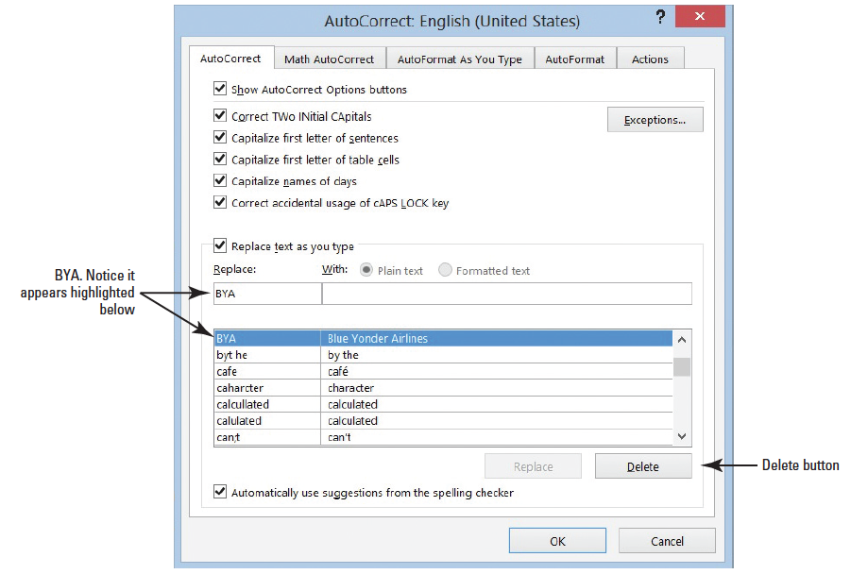
Step by Step: Configure AutoCorrect Options
In the Replace box, type BYA. BYA and Blue Yonder Airlines are highlighted in the list of AutoText exceptions, as shown at right.
Click the Delete button to remove the highlighted entries. Now, if you type BYA in your document and press the Spacebar, no action will occur.
SAVE the file as Employment Offer1 in the lesson folder on your flash drive.
PAUSE. LEAVE the document open to use in the next exercise.

Slide 36
Step by Step: Insert Special Characters Using AutoCorrect
USE the document from the previous exercise.
Position the insertion point after the s in Airlines in the first paragraph.
Blue Yonder Airlines is the trademark name for the company and requires the trademark symbol after the name.
Type (tm) to insert the trademark symbol after Airlines. The trademark symbol is placed in the document as a superscript element.
SAVE the file as Employment Offer2 in the lesson folder on your flash drive.
PAUSE. LEAVE the document open to use in the next exercise.

Slide 37
Step by Step: Disable AutoCorrect
USE the document from the previous exercise.
By default, the AutoCorrect Options are enabled. To disable AutoCorrect, begin by repeating steps 1–3 under the Configure AutoCorrect Options section.
Click to clear the check mark from Replace text as you type. The feature is off and the Automatically Use Suggestions from the Spelling Checker option located at the bottom of the dialog box is shaded gray to show that it is unavailable.
To enable the AutoCorrect function, click the check box again; a check mark appears in the box and the Automatically Use Suggestions from the Spelling Checker option again becomes available. (Check with your instructor to determine whether you should leave AutoCorrect disabled or enabled.)
PAUSE. LEAVE the document open to use in the next exercise.

Slide 38
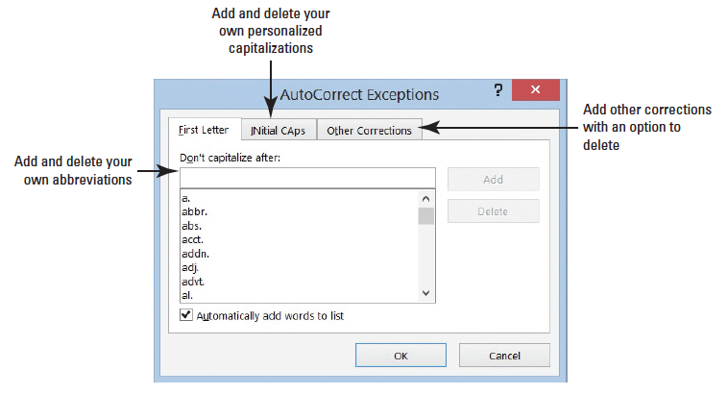
Step by Step: Use Exceptions in AutoCorrect
USE the document from the previous exercise.
The AutoCorrect dialog box should still be open. If not, repeat steps 1–3 under the Configure AutoCorrect Options section.
Click the Exceptions button. The AutoCorrect Exceptions dialog box opens (right). If you use a word that is not in the main dictionary, you can add it using the AutoCorrect Exceptions.
Click the INitial CAps tab and type IDs.

Slide 39
Step by Step: Use Exceptions in AutoCorrect
Click the Add button.
Click OK to close the AutoCorrect Exceptions dialog box. When a word is added to the Exception list, the word is also added to the default custom dictionary.
Click OK to close the AutoCorrect dialog box.
Click OK to close the Word Options dialog box. At the end of the fourth paragraph, type Employee IDs will be provided to you on location. Adding IDs to the exceptions avoids flagging the word.
SAVE the document as Employment Offer3 in the lesson folder on your flash drive.
PAUSE. Leave the document open to use in the next exercise.

Slide 40
Inserting and modifying comments in a document
Word’s new Comment feature enables reviewers to integrate people and communication in different settings.
The new visual look catches your attention with the new Person Card shown on the right side of the document with the individual’s name and picture—this identifies the user who made the comment and has an active Microsoft account. The Person Card allows you to check whether the person is available and communicate with them through IM, voice, video, or one of the latest social sites.
The new Word 2013 default view for comments is the Simple Markup that gives the document a more polish look, and a little balloon appears alongside of the document.
If you use your tablet or computer to read your comments, you can read your document without the clutter of markups displayed on your screen—which makes for easier reading.

Slide 41
Inserting, Editing, and Deleting a Comment
The commands in the Comments group are used to insert comments to yourself or for others to provide feedback.
When the Person Card appears, this indicates that this individual has a Microsoft Account and has signed in to one of the Office 2013 applications. When a comment is added to the document, the person’s profile appears as a card when comments are displayed.
Microsoft has improved the comments features by allowing you to communicate with individuals who have commented on your document by providing the options in the Person Card.

Slide 42
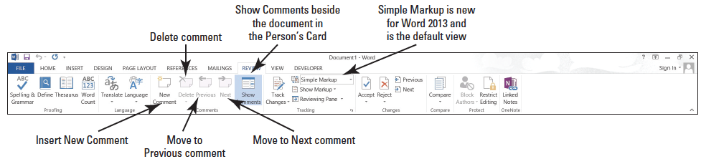
Inserting, Editing, and Deleting a Comment
Another new feature in Word 2013 is marking a comment as done—instead of deleting a comment.
Comments are easily added by using the New Comment button or using the shortcut menu. Comments can be deleted, marked as done, and edited.
Moving through a document with comments can be accomplished using the navigation buttons on the Ribbon.

Slide 43

Step by Step: Insert a Comment
USE the document from the previous exercise.
In the first sentence of the second paragraph, select $55,000.
On the Review tab, in the Comments group, click the New Comment button.

Slide 44
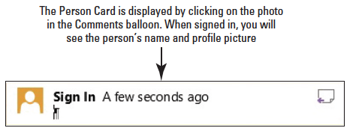
Step by Step: Insert a Comment
A new comment appears in the right margin, labeled with the individual’s name and photo icon. To see the Person Card, hover over or click on the photo icon. As you continue adding comments in a document, you will see when the comment was added in minutes—eventually this will change to the date the comment was added after the document is shared. For this lesson, images in the figures appear as Sign In, as shown below.

Slide 45
Step by Step: Insert a Comment
Type into the comment balloon Will you please confirm if the salary is correct?
In the first sentence of the third paragraph, select $2,500.
Right-click, and then select New Comment from the menu; a second comment appears in the right margin.

Slide 46
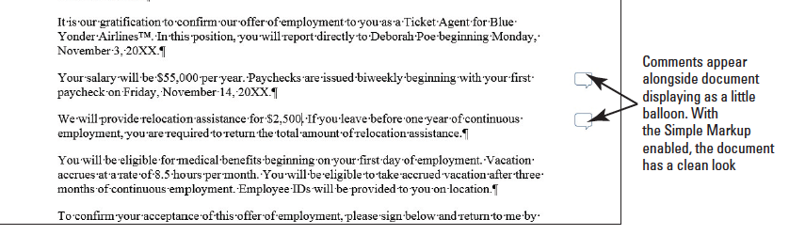
Step by Step: Insert a Comment
In the new comment, type The relocation amount is $5,000. The figure below displays both comments as balloons. If your screen is not displaying as shown in the figure, click the Simple Markup in the Tracking group.
SAVE the document as Employment Offer Comments in the lesson folder on your flash drive.
PAUSE. Leave the document open to use in the next exercise.

Slide 47

Step by Step: Navigate and Edit a Comment
USE the document from the previous exercise.
Click the Previous button in the Comments group to move back to the first comment.
When you jump to a comment, you are ready to begin editing.
Place the insertion point at the end of the text in the first comment, and type I would appreciate a response by 5 p.m. today.
SAVE the document in the lesson folder on your flash drive.
PAUSE. Leave the document open to use in the next exercise.

Slide 48
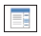
Step by Step: Show Comments
USE the document from the previous exercise.
Click the Show Comments button to display comments in the document.
The comments are placed on the right side of the document and if you hover over them, you see how long ago the comment was added. If the person has signed into his or her Microsoft account, you also see his or her name and picture.
The Show Comments button is a toggle to show and hide comments.
PAUSE. Leave the document open to use in the next exercise.

Slide 49

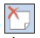
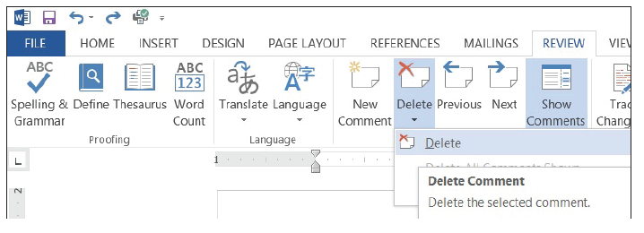
Step by Step: Delete and Mark Comment as Done
USE the document from the previous exercise.
Click the Next button in the Comments group to move to the second comment balloon.
Click the Delete button drop-down arrow in the Comments group, and then select Delete from the drop-down menu, as shown below. The comment is removed.
Notes:
Another Way: You also can delete a comment by right-clicking on it and selecting Delete Comment from the shortcut menu.

Slide 50
Step by Step: Delete and Mark Comment as Done
Click Undo to bring the comment back.
Right-click both comments separately and click Mark Comment Done.
This option shrinks and fades all comments and places them in the document background.
Remove the check mark from both comments.
SAVE the document as Employment Offer Comments1 in the lesson folder on your flash drive.
PAUSE. Leave the document open to use in the next exercise.
Notes:
Take Note: You can also reverse the action by right-clicking on the comments individually and clicking Mark Comment Done to remove the check mark. Remove the check mark from both comments.

Slide 51
Viewing Comments
Word displays comments as little balloons in the document with the default Simple Markup enabled.
Comments can also be shown inline in the document or as balloons.
Balloons are markups and when comments are shown, the person’s card displays on the right side of the document.
Inline comments are hidden; the reviewer’s initials appear in square brackets beside the selected text. ScreenTips appear when comments are inline and the mouse pointer is placed over the inline comment.
Both the balloons and inline can be used with track changes, which is discussed later in the lesson.
The Show Markup menu allows you to change how comments appear and to determine which reviewers’ comments are displayed. When in Draft view, certain elements in a document are not visible.

Slide 52

Step by Step: View Comments Inline
USE the document from the previous exercise.
In the Tracking group, click the Track Changes button to turn on. The button is now highlighted to show it is on. Track Changes must be turned on to view comments Inline.
Click the drop-down arrow by Simple Markup and select All Markup to change the default setting for the markup.

Slide 53

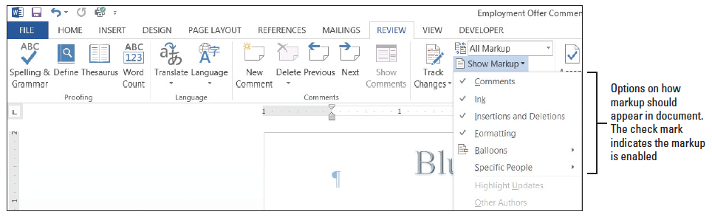
Step by Step: View Comments Inline
In the Tracking group, click the Show Markup button to display the menu as shown below. Options are available on how markup should display in the document.

Slide 54
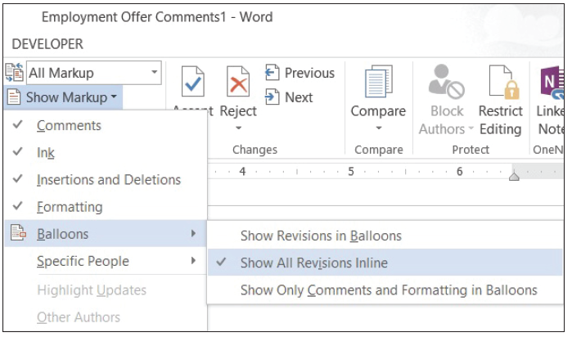
Step by Step: View Comments Inline
Select Balloons, and then click Show All Revisions Inline (below).

Slide 55
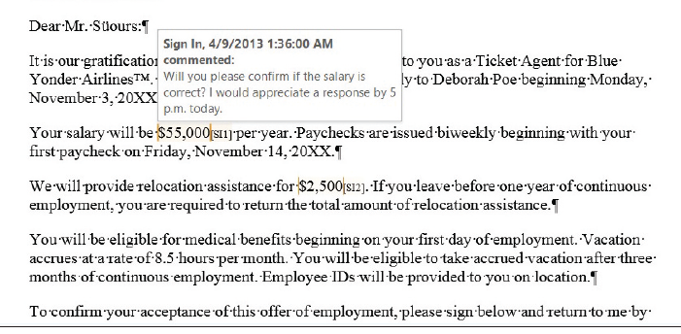
Step by Step: View Comments Inline
Position the mouse pointer over your initials. The com- ment appears in a ScreenTip, as shown at right. Inline comments are hid- den and indicated by bracketed reviewer initials beside the selected text.
SAVE the document as Employment Offer Comments2 in the lesson folder on your flash drive.
PAUSE. Leave the document open to use in the next exercise.

Slide 56
Step by Step: View Comments as Balloons
USE the document from the previous exercise.
Click the Show Markup button to display the menu.
Select Balloons, and then click Show Revisions in Balloons. The comment are shown in a balloon in the Markup area.
SAVE the document as Employment Offer Comments3 in the lesson folder on your flash drive, and then CLOSE the file.
PAUSE. Leave the document open to use in the next exercise.

Slide 57
Step by Step: Hide and Show Reviewer Comments
USE the document from the previous exercise.
OPEN the Initial Employment Offer document in the lesson folder. The document opens with the All Markup settings selected.
In the Tracking group, change the markup to Simple Markup.
In the Comments group, the Show Comments button should be highlighted displaying all comments by all reviewers.

Slide 58
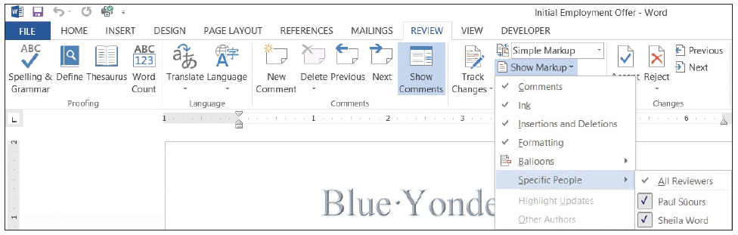
Step by Step: Hide and Show Reviewer Comments
Click the Show Markup button and select Specific People as shown below

Slide 59
Step by Step: Hide and Show Reviewer Comments
In the drop-down list of All Reviewers, click the check box beside Paul Süours to remove the check mark. Both comments no longer appear in the document because Sheila Word responded to Paul’s concerns.
SAVE the document as Initial Offer Comments in the lesson folder on your flash drive.
PAUSE. Leave the document open to use in the next exercise.

Slide 60
Displaying the Reviewing Pane
Comments and track changes are tracked on the Reviewing Pane either vertically on the left side of the screen or horizontally across the bottom of the screen.
When the Reviewing Pane opens, a summary displays the number of insertions, deletions, moves, formatting, and comments that have been made in the document.

Slide 61
Step by Step: Display the Revisions Pane
USE the document that is open from the previous exercise.
From the Review tab, in the Tracking group, click the Reviewing Pane drop-down arrow and select Reviewing Pane Horizontal from the drop-down menu. The Revisions Pane opens horizontally across the bottom of the Word window. It tracks and documents all changes.

Slide 62
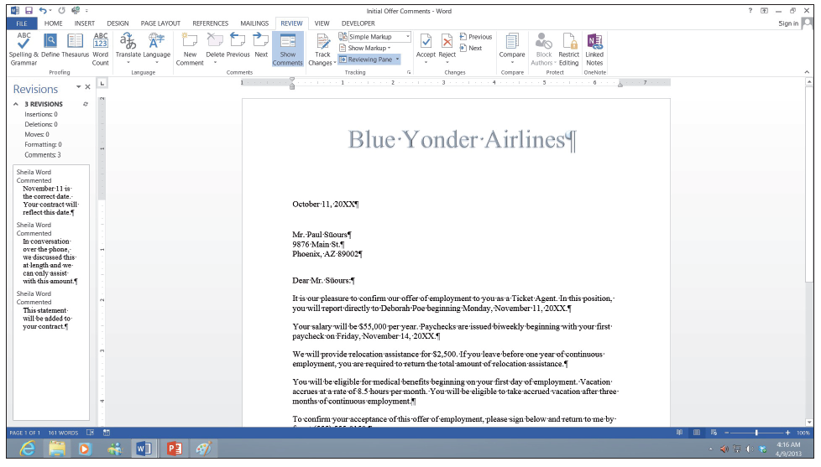
Step by Step: Display the Revisions Pane
To view the Revisions Pane vertically, click the Reviewing Pane drop-down arrow and select Reviewing Pane Vertical. The Revisions Pane displays vertically along the left side of the document as shown below.

Slide 63
Step by Step: Display the Revisions Pane
Click the X on the Vertical Reviewing Pane to close or click the Reviewing Pane button to close.
SAVE the document in the lesson folder on your flash drive, and then CLOSE the file.
PAUSE. LEAVE Word open for the next exercise.

Slide 64
Tracking Changes in a document
The Track Changes command enables reviewers to track revisions and feedback from other users.
With the new Person Card, you can easily identify who has made changes and where the changes were made in the document.
With the new Simple Markup being the default, changes made in a document display a red line near the left margin.
When you click the red line or balloon, the view of the markup changes to the All Markup view. If you want to see only comments in the document and not changes, then click the Show Comments button.

Slide 65
Tracking Changes in a document
To begin tracking changes, click the Track Changes button and to turn off, click again. You see the button highlighted when turned on.
A new feature in tracking changes is Lock Tracking—this prevents anyone from turning Track Changes off. After reviewing all changes in the document, you accept or reject changes. For permanent changes, you need to accept or reject and stop tracking.
Additional choices are provided on how markups appear in the document. Simple Markup is the default; the other choices are All Markup, which displays all changes and comments; No Markup, which displays the document in a final copy without the markup; Original, which displays the original document with no markups.

Slide 66
Tracking Changes in a document
The Show Markup menu allows you to change how changes or comments appear in the document. The markups can appear as balloons, inline, or shown only with comments and formatting in balloons.
The appearance of changes can be changed by disabling comments, ink, insertions and deletions, and formatting. By default, these are enabled.

Slide 67
Tracking Changes in a document
When there are several individuals who have made changes in a document and you want to see changes from only specific individuals, you can specify which ones to display in your document.
The Track Changes Options dialog box allows you to change the user name. Additional options are available but is not discussed in this lesson.
In this exercise, you learn to change a user’s name, track changes, change how markups are displayed, print markups, lock tracking, and accept and reject changes.

Slide 68
Step by Step: Change a User’s Name
OPEN the Handbook document from the lesson folder.
LAUNCH the Tracking Changes Options dialog box by clicking the arrow on the Tracking group.
Click the Change User Name button.
The Word Options dialog box opens in Backstage.
Under Personalize your copy of Microsoft Office, type Aggie Becker in the User name box, and then type ab in the Initials box.
Click OK to close the Word Options dialog box.
Click OK to close the Track Changes Options dialog box.
PAUSE. LEAVE the document open to use in the next exercise.
Notes:
Another Way: To change the user name, click File, and then click Options to open the Word Options dialog box. Type your name and initials under Personalize your copy of Microsoft.

Slide 69
Step by Step: Track Changes in a Document
USE the document from the previous exercise.
Display the Review tab, and then click the Track Changes button to turn on.
In the first paragraph of the first sentence, select B & B, and then press Delete. The Simple Markup displays a red line on the left margin, letting you know that a change has been made.

Slide 70
Step by Step: Track Changes in a Document
In the same paragraph, select B & B. Bold and color the text dark red. The text appears in the document with changes made.
Position the insertion point in the second paragraph, in front of B in B & B and type Books and Beyond. The new inserted text is shown in the document.
Select B&B, and then press Delete. A second markup is placed on the left margin.
SAVE the document as Handbook Draft1 in the lesson folder on your flash drive.
PAUSE. LEAVE the document open for the next exercise.

Slide 71
Step by Step: Change Markups in a Document
USE the document from the previous exercise.
Click the drop-down arrow by the Simple Markup and select All Markup. The markups are displayed in the right margin showing where text has been deleted with a dashed line showing the location of deletion. The author’s name appears in the document as shown on the next slide because the user has not signed into his or her Microsoft account. The inserted text is underlined and displays in the default track changes color.
Notes:
Take Note: By default, the Simple Markup is enabled and the markup is displayed in the left margin where changes have been made. When text is inserted in a document, it displays in the document.

Slide 72
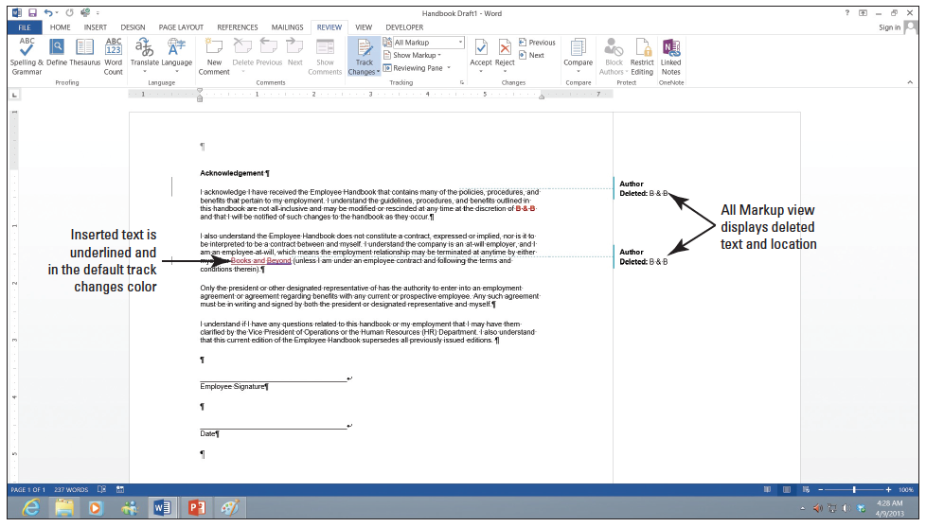
Step by Step: Change Markups in a Document

Slide 73
Step by Step: Change Markups in a Document
Click the drop-down arrow by All Markup and select No Markup. No markups appear in the document.
Change the No Markup to Original. The document is returned to its format displaying only the formatted text.
Return the document back to display Simple Markup.
SAVE the document in the lesson folder on your flash drive.
PAUSE. LEAVE Word open for the next exercise.

Slide 74
Step by Step: Show Markups in a Document
USE the document from the previous exercise.
Click the drop-down arrow by Show Markup to display the menu. The check mark indicates that the markups for these features are enabled.
Click the check mark by Insertions and Deletions to turn off. The markups no longer display in the document.
Turn the Insertions and Deletions back on.
SAVE the document in the lesson folder on your flash drive.
PAUSE. LEAVE Word open for the next exercise.

Slide 75
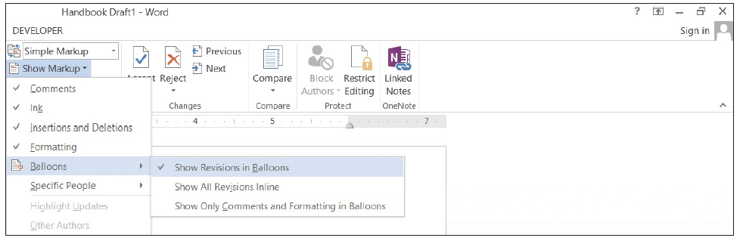
Step by Step: Display Markups in Balloons and Inline
USE the document from the previous exercise.
Click the drop-down arrow by Show Markup, and then select Balloons. A check mark is placed by Show Revisions in Balloons as shown below.
Select Show All Revisions Inline. Notice that no changes occurred in the document. To view changes inline, the markup must be in All Markup view.

Slide 76
Step by Step: Display Markups in Balloons and Inline
Change to All Markup view, and then hover over the deleted text in the document to see markup inline.
SAVE the document as Handbook Draft2 in the lesson folder on your flash drive.
PAUSE. LEAVE Word open for the next exercise.

Slide 77
Step by Step: Print Markups
USE the document from the previous exercise.
From the File tab, click the Print command to open the additional options. In Lesson 1, you learn about using some of the print settings.
Under Settings, click the drop-down arrow, and then select List of Markup.
Click the Print button to produce a copy of the markups made in the document. The markups print comments and changes made in the document.
PAUSE. LEAVE Word open for the next exercise.

Slide 78
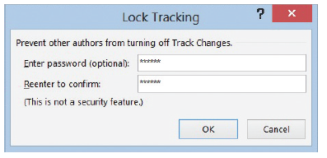
Step by Step: Use Lock Tracking
USE the document from the previous exercise.
Click the drop-down arrow by Track Changes and select Lock Tracking.
Type the password HDBK^%, and then reconfirm by typing the password again.
Click OK (see below). The Track Changes, Accept, and Reject buttons turn gray and are not accessible.
Notes:
Take Note: Track Changes can be locked with a password and this prevents anyone from turning track changes off. When it’s locked, the Track Changes button cannot be turned off nor can you accept or reject changes in the document.

Slide 79
Step by Step: Use Lock Tracking
Select Lock Tracking, and then reenter the password HDBK^% to turn the commands back on. It is good practice to write all your passwords down and keep them in a safe place. If you cannot remember your password, you will not be able unlock Track Changes.
SAVE the document in the lesson folder on your flash drive.
PAUSE. LEAVE Word open for the next exercise.

Slide 80
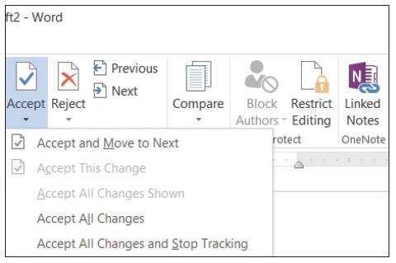
Step by Step: Accept and Reject Changes
USE the document from the previous exercise.
In the Changes group, click the drop-down arrow under Accept to produce a menu as shownbelow.
You have options on accepting the changes one at a time or all at once.
Click Accept and Move to Next.
Word accepts the changes and jumps to the next change in the document.

Slide 81
Step by Step: Accept and Reject Changes
Click the drop-down arrow under Reject to produce a menu.
Click Reject and Move to Next. The change made to insert text is not inserted in the document.
Change the view by selecting No Mark to display for review. This is what the final version of the document will look like. The changes are not deleted and will display again each time the document is opened. Note, to delete the track changes permanently, you must accept or reject changes and stop tracking.
Before closing the document, click the Track Changes button to turn it off.
SAVE the document as Handbook Final in the lesson folder on your flash drive.
CLOSE Word.

Slide 82
Skill Summary

